Slide 1
RDD ANALYSIS OF BANKS’ DEBT COLLECTION STRATEGIES

Slide 2
OVERVIEW
Purpose
Verifying that a bank’s Debt collection strategies actually work
Stakeholders
Commercial Banks and other financing entities such as – Credit Unions, Insurance Firms, Brokerages, etc.
Process
Utilizing a Regression Discontinuity Design model, testing the effect on actual collection rates vs expected collection rates of a bank’s debt collection strategies

Slide 3
DATA ACQUISITION & SUMMARY
The data was collected from one of the leading US Banking firms (unnamed to preserve anonymity).
The dataset contains details about customers’ age and gender and the defaulted amount on their accounts, the expected recovery amount and the actual amount recovered from these accounts.
The dataset also contains a categorical explanatory variable which is the main variable in our RDD model, namely – Recovery Strategy Level.
The recovery strategies each have their own thresholds, higher the amount to be recovered, better is the employed recovery strategy.
Each level of recovery strategies involves an additional $50 cost incurred to the bank per customer as compared to the previous level of strategy employed.

Slide 4
Problem Statement & Hypothesis
The main issue being analysed here is whether to employ a certain level of recovery strategy for each customer.
As an account is labelled to be ‘uncollectable’, the bank doesn’t just simply walk away from the debt that its owed.
They still try to recover some of the money they’re owed. Hence, they label customers or rather their accounts on a scale of Level 0 to Level 4 based on evenly spaced $1000 thresholds of debt.
Our hypothesis today is that recollection strategies do hold an important place in enabling the bank to collect what it’s due, beyond the bank’s expectations regarding recollection.

Slide 5
Data exploration
To verify if there are other factors besides Expected Recovery Amount that also varied systematically across the $1000 threshold we conduct graphical and statistical analyses for the remaining candidate explanatory variables.
A scatter plot of Age vs Actual Recovery amount and a boxplot of Sex vs Actual Recovery Amount would provide a good visual proof that these remain the same across thresholds and don’t affect out dependent variable.
We supplement these assumptions and visuals with Chi-Square and Kruskal-Wallis tests respectively.
The p-values for each show us that these variables are evenly spread throughout the dataset and as such do not offer any explanations in the y-variable variance.
Graphical and Statistical analyses for Expected amounts and recovery strategies also show that we can move forth with our RDD analysis over these variables.

Slide 6
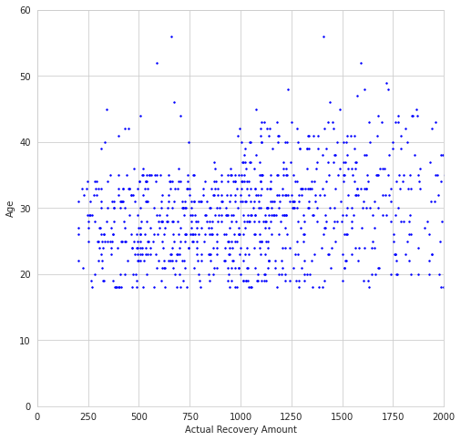
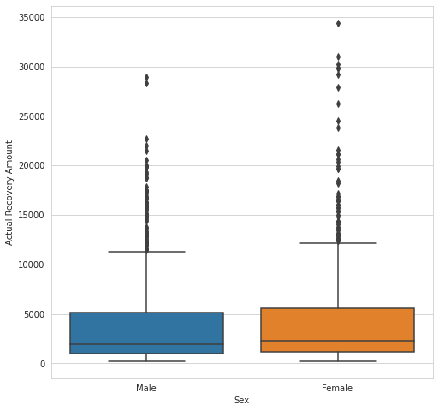
The p-value of 0.53 is enough for us to fail to reject the Null Hypothesis that Recovery Amount and Sex of a person are independent of each other at the 10% significance level. Thus, this also implies that the value of recovery strategies assigned to accounts doesn’t depend on sex.
The p-value of 0.092 is enough for us to reject the Null Hypothesis that avg Age varies across the threshold at the 10% significance level.

Slide 7
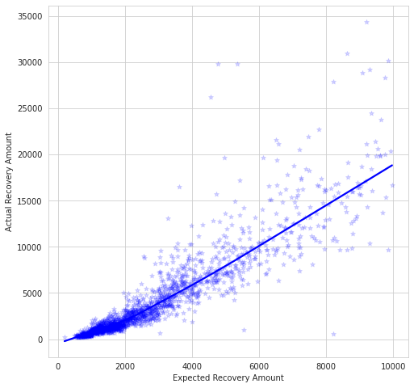
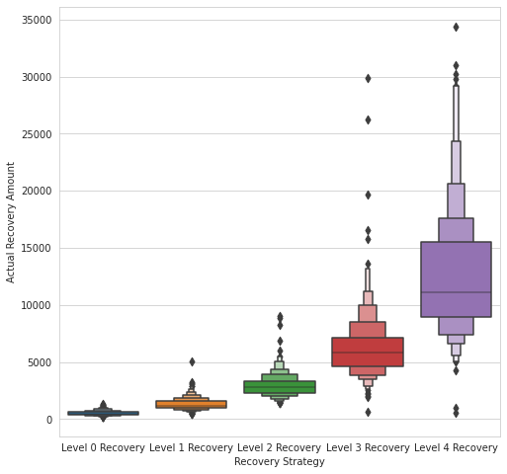
The p-values of 0.35 and 0.84 are enough for us to fail to reject the Null Hypothesis that avg actual and avg expected recovery amounts vary across the different thresholds at the 10% significance level.
The p-value of 1.033e-66 is enough for us to reject the Null Hypothesis that Recovery Amount and Strategy Level of an account are independent of each other at the 10% significance level.

Slide 8
MODELLING
As is common with RDD models, we first ran a regression without our interaction variable (Expected Recovery Amount * Recovery Strategy employed) so as to show the actual effects of using the recovery strategy (Level 1) causes a jump (discontinuity) at the $1000 threshold in actual amount recovered.
We extend this model to higher strategy levels (Levels 2, 3, and 4) at higher thresholds ($2000, $3000, and $4000 respectively) and supplement our analysis with graphical proofs to visualize the jump caused by the respective strategies.
We can also compare the R² of the controlled model with our experimented models to see a better explanation of the variance in the actual amount recovered.
The regression tables show us the coefficient values and the p-values of each interaction variable. All are significant on a 1% level indicating that our hypothesis was in fact, correct.

Slide 9
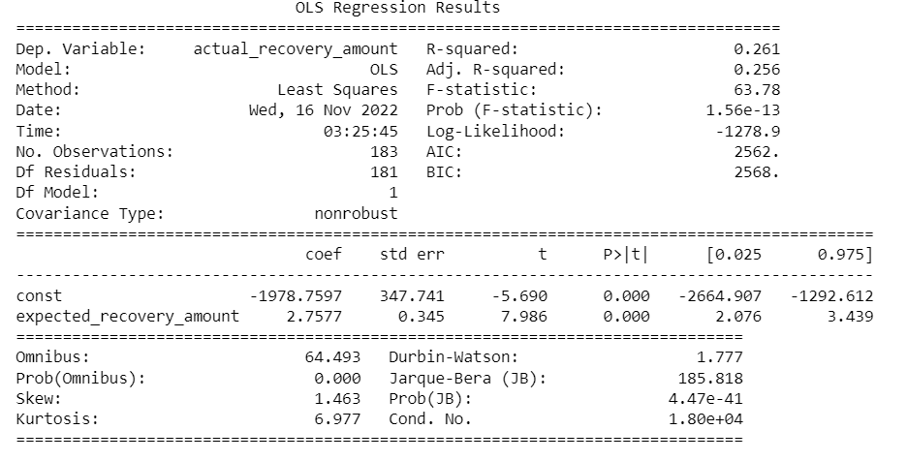

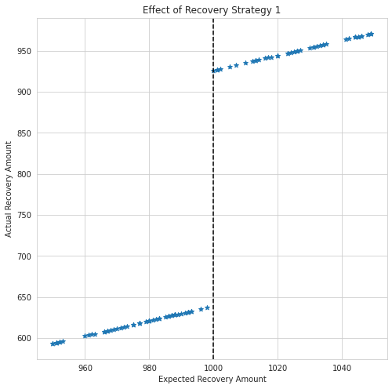
Table 0 (Control Model)
Table 1 (Experimental Model)
We see that our experiment model has an R² of 0.28 which is higher than the base model’s 0.26
Furthermore, we see that Strategy level 1 would collect $286 more than the expected recovery amount. Thus, instead of collecting the expected debt from people whose defaulted accounts belong in the in the Strategy 1 category, the bank collects an extra $286.
This is much higher than the $50 it requires to keep the recovery strategy programme running at this level.
The p-value tells us that our results are statistically significant.

Slide 10
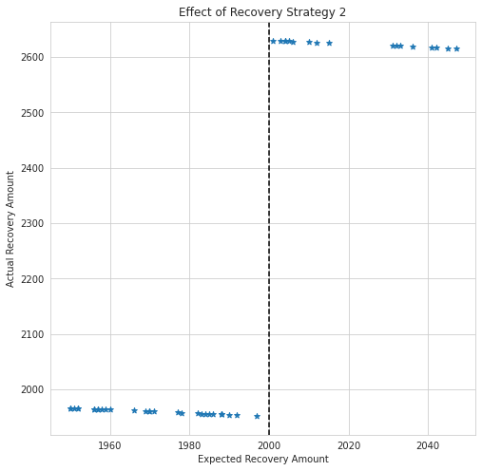
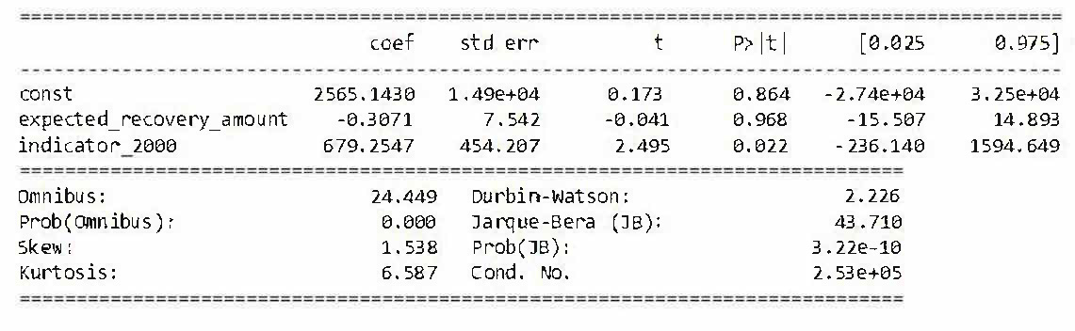
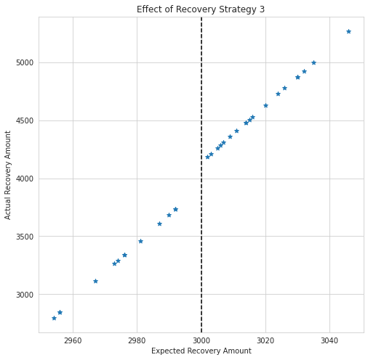
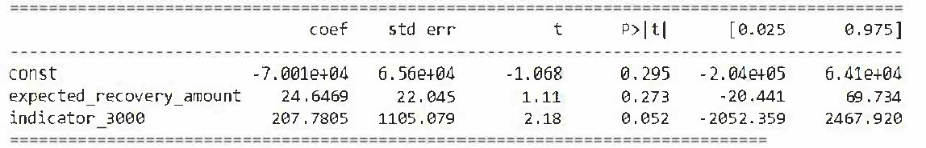
Table 2
Table 2 shows us that Strategy level 2 would collect $679 more than the expected recovery amount. Thus, instead of collecting $2000, the bank collects $2679. Our results are still statistically significant.
Table 3 shows us that Strategy level 3 would collect $207 more than the expected recovery amount. Thus, instead of collecting the expected debt, the bank collects an extra $207. Our results even for this RDD are statistically significant.
These amounts are also much higher than the extra $50 it requires to keep the recovery strategies running at the respective programme levels.
Table 3

Slide 11
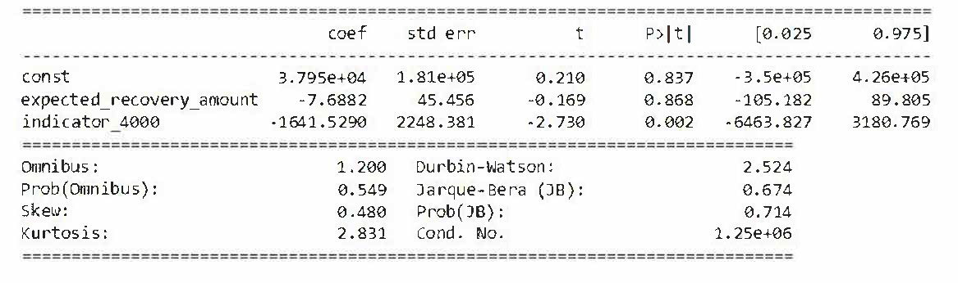
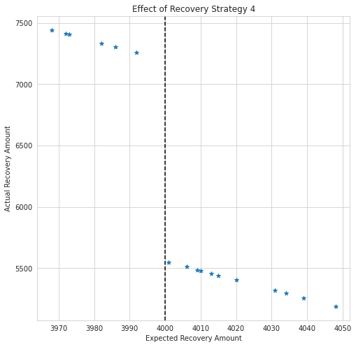
Table 4
Finally, we see that Strategy level 4 would collect $1641 less than the expected recovery amount. Thus, instead of collecting the expected debt from people whose defaulted accounts belong in the in the Strategy 4 category, the bank collects $1641 lesser.
Since, this is much lower than the $50 it requires to keep the recovery strategy programme running at this level, the bank should stop putting in the extra effort to collect their debts from people in this category
The p-value tells us that our results are statistically significant.

Slide 12
Conclusions
Thus, we see that the bank should keep employing Recollection Strategies 1 through 3 as these end up recovering more than what the bank expected and are lucrative enough to keep running the programme as well.
The bank should abandon Strategy 4 as the costs incurred far outweigh the amount recollected from the defaulted accounts (which is already less than what the bank was expecting).
Further steps would be to include a probable triple interaction term with another variable so as to improve the chances/amounts of recollection and subsequently also improve the effect the bank’s recollection strategies.
Finally, more datapoints always come in handy if we are to extend this type of verification model to larger institutions than smaller commercial banks.

